Slide 1


Slide 2
RAGHack streams
aka.ms/RAGhack
Week 1: September 3 - 8
9
MONDAY
3
TUESDAY
4
WEDNESDAY
5
THURSDAY
6
FRIDAY
7
SATURDAY
8
SUNDAY
RAG 101
.NET
Azure AI Studio
Python
Langchain4J
LangchainJS
Responsible AI
MongoDB
Azure AI Search
PostgreSQL
Azure SQL
GraphRAG
Multi-channels
Hack!
Hack!
Hack!
Hack!
Hack!
Hack!
Week 2: September 9 - 14
9
MONDAY
10
TUESDAY
11
WEDNESDAY
12
THURSDAY
13
FRIDAY
14
SATURDAY
15
SUNDAY
Semantic Kernel
Spring AI
Vision models
Internationalization
VSCode Agent
Agentic RAG
Code Interpreter
AI Studio Advanced
AutoGen
Data Access Control
Fine Tuning
Model catalog
Evaluations
Hack!
Hack!
Hack!
Hack!
Hack!
Hack!
Hack!
Hack!
Hack!
Submissions due September 16, 11:59 PM PT!

Slide 3
多语言支持
Spanish:
aka.ms/RagHack2024Espanol
Portuguese:
aka.ms/S-1374
Chinese:
aka.ms/S-1380
RAG: Generación Aumentada de Recuperación
Prácticas recomendadas de Azure AI Search
AI Multi-Agentes: Patrones, Problemas y Soluciones
RAG (Geração Aumentada de Busca) no Azure
Construindo RAG com Azure AI Studio e Python
Implantando RAG com .NET e Azure Developer CLI
Global RAG Hack Together
Create RAG apps with Azure AI SDK
Create RAG applications with AI Toolkit VSCode Extension
Intro to GraphRAG

Slide 4
RAGHack prizes
Best overall
Best in JavaScript/TypeScript
Best in Java
Best in .NET
Best in Python
Best use of AI Studio
Best use of AI Search
Best use of PostgreSQL
Best use of Cosmos DB
Best use of Azure SQL
Each winning team will receive a cash prize of $500 💰

Slide 5
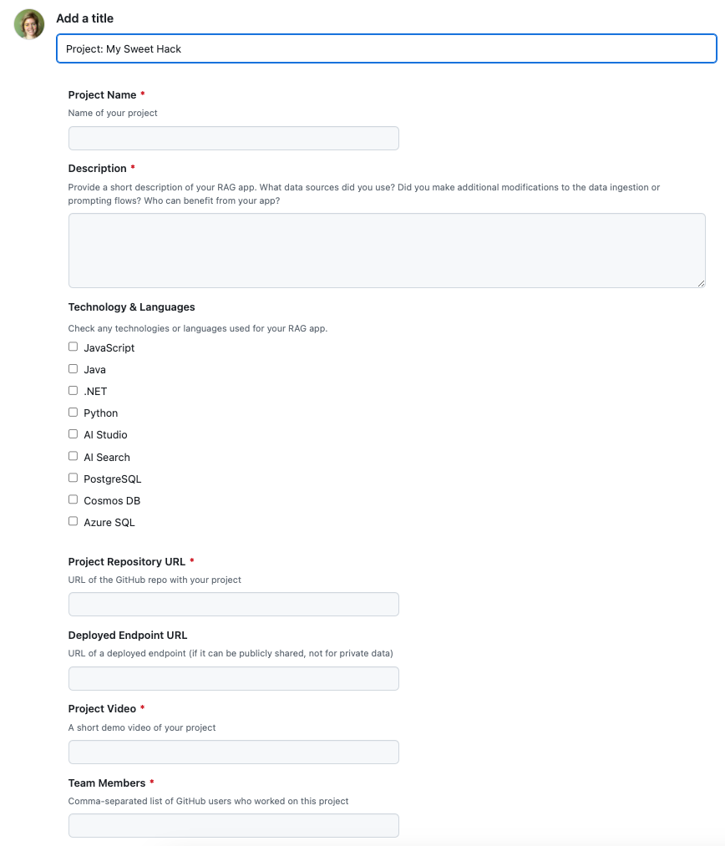
RAGHack submission process
通过注册任何 RAGHack 直播进行注册，链接如下： aka.ms/raghack/streams
太平洋时间 9 月 16 日晚上 11:59 之前，请在 aka.ms/raghack 中提交问题并填写所有字段，以提交您的 hack。项目存储库和演示视频是必需的，部署的端点是可选的。如果有团队成员，请包括他们。
等待几周让评委来评分！

Slide 6
RAG: Azure AI SDK
Kinfey Lo
AI Senior Cloud Advocate
github.com/kinfey

Slide 7

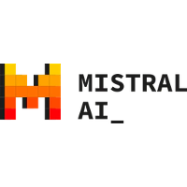

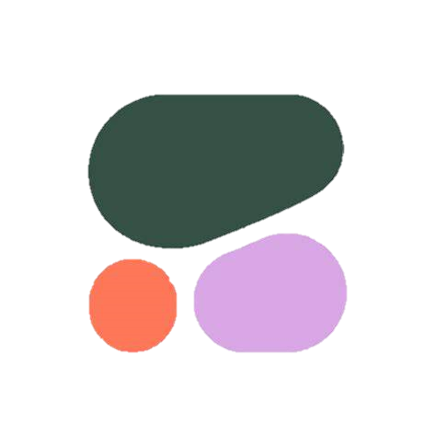






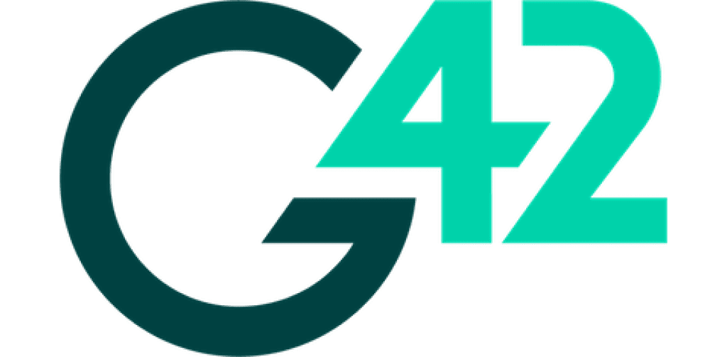

Azure AI offers the best model selection
LLMs and SLMs
Modalities, tasks and tools
Regional and domain specific
Open and propriety
Flagship LLMs
GPT-4
Mistral Large
Llama3 70b
Command R+
Small Language Models
Phi3
Mistral OSS models
Llama3 8b
Multi-modal
GPT-4o, Phi3-vision
Image generation
Dalle3, Stability AI
Embedding models
Ada, Cohere
Function calling & JSON support
Core42 JAIS Arabic language LLM
Mistral Large is focused on European languages
Nixtla TimeGEN-1 - Timeseries forecasting
Premium models first on Azure: OpenAI, Mistral Large, Cohere Command R+
100s of Open models from HuggingFace
Open models from Meta, Databricks and Snowflake, Nvidia
Microsoft Phi
Azure OpenAI
Mistral AI
Meta AI
Databricks
Cohere
Hugging Face
NVIDIA
Deci AI
Nixtla
G42
Snowflake

Slide 8


Model catalog offers flexible deployment options
Managed compute
Deployed to managed Azure VMs
One click deployment that boots up an optimized container and initializes the weights.
Pay-per-GPU billing
100s of open models
Serverless APIs
with Azure Open AI Service
and Models as a Service
Ready to use model APIs
Pay-per-token or pay-for-provisioned-capacity billing
30+ flagship models

Slide 9
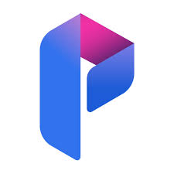
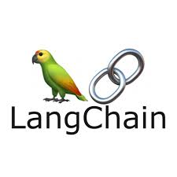





Azure AI model inference API works with favorite SDK
Consistent schema
Unified API schema that works across all models
Advanced capabilities
Custom parameters that are unique to each model
Advanced capabilities like function calling and JSON support
Rich client support
“Model inference SDK” for multiple languages
Integration with LLM App development tools like prompt flow, Lang Chain, Semantic Kernal and more
Azure AI Prompt Flow
+
azure-ai-inference SDK
(coming in early June)
Popular OSS tools like
Lang Chain and Semantic Kernel
Model provider SDKs

Slide 10


Azure AI Search
功能丰富的
向量数据库
从任何来源获取任何类型的数据
无缝数据和
平台集成
最先进的搜索排名
企业基础

Slide 11
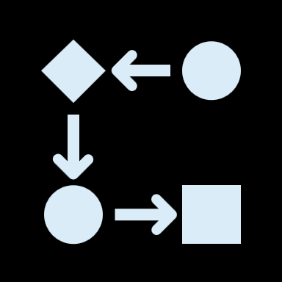
Vector Search
详尽的 KNN 和 ANN 搜索策略
多模式、多语言相似性搜索
包含或排除信息的过滤器
端到端数据提取、分块、向量化和检索
与 Semantic kernel、LangChain、Azure OpenAI Service 和 AML Promptflow 集成
Notes:
And while these off-the-shelf copilots can be leveraged to boost productivity, optimize efficiency and cost savings, and secure your organization…
We understand that companies may also want to explore using AI in other, more extensive, ways to develop custom solutions.
AI-powered apps that, when combined with the right data foundation, can unlock transformative experiences that enable contextual interactions, amplified automation, and intuitive discovery with customers and within your organization.
And this is the same AI platform that you can use to build intelligent apps of your own.

Slide 12


Integrated vectorization
Chunking
Vectorization
内置分块技能（更新拆分技能）和索引更新，用于管理分块与完整文档。
配置分块参数（例如页面、重叠窗口等）
通过索引器编排实现自动化
自带 Azure OpenAI 服务端点
通过自定义技能支持其他嵌入模型 REST 端点
查询向量化功能

Slide 13
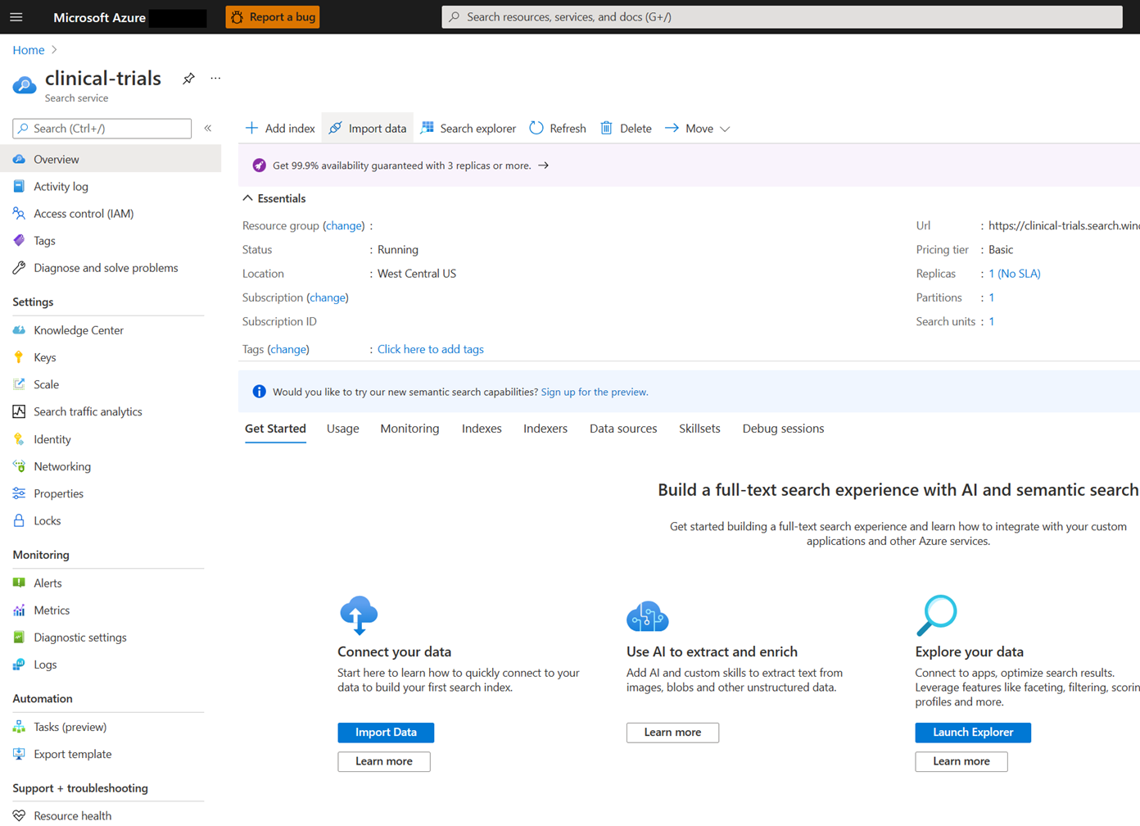
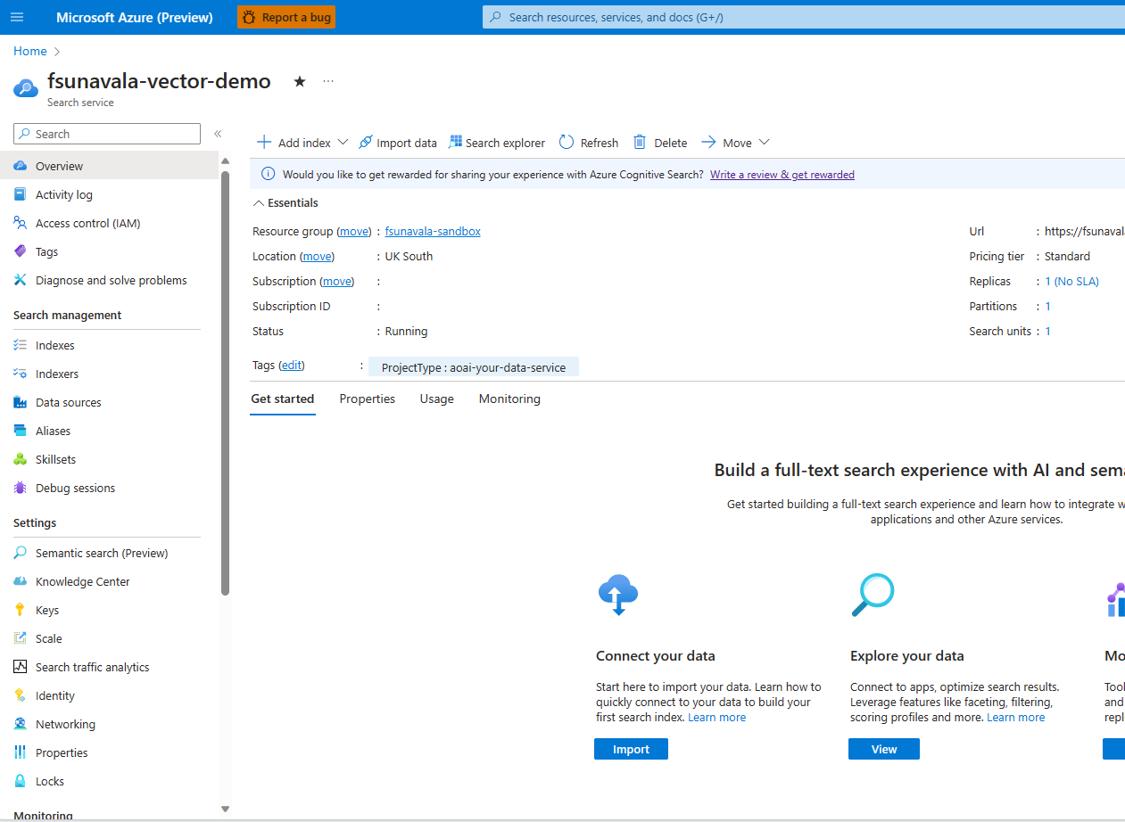
Azure AI Search
Platform-as-a-Service
Semantic search
management free keyword search faceting language analyzers geospatial support suggestions/auto-complete customizable scoring proximity search synonyms cognitive skills etc.

Slide 14
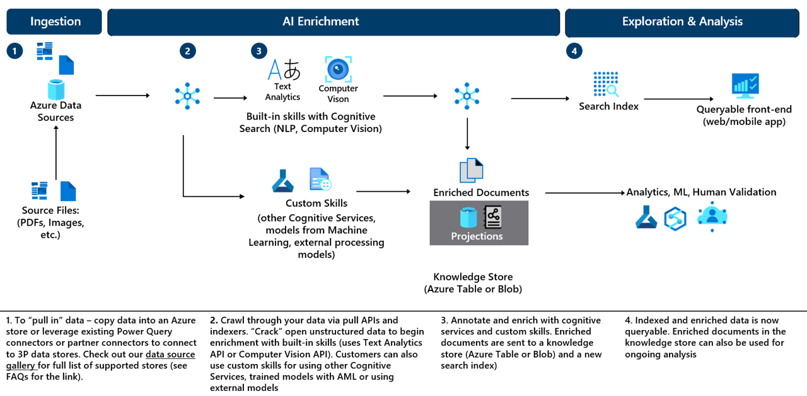
Typical Azure Cognitive Search Architecture Diagram
Notes:
Typical architecture diagram for ACS

Slide 15
我们如何做 RAG ？

Slide 16
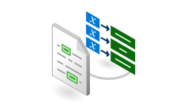
How to create RAG
2
5
Search query / questions (incl. filters, facets, scoring profiles, etc.)
?
Section 1
Expert Systems
Section 2
User
Application
Azure AI
Search
Search Index
1
Document Chunking
Function
Section 3
Section 4
Azure Form Recognizer
Layout Model
3
Azure OpenAI
Service
Response:
Summarization,
Q&A, references, etc.
N-Relevant Sections
Prompt
4
Document Library
1. 数据提取
2. 分块
3. 索引
4. Prompting
5. 用户界面
不同的数据格式
最好的分块策略是什么？
应该使用向量、语义还是传统方法？
工具、技巧和策略
如何展现信息？

Slide 17
2. Chunking
Section 1
Section 2
Document Chunking
Function
Section 3
Section 4
Notes:
Let’s learn more about how data is prepared for the retrieval step.

Slide 18
Document Chunking
Benefit Options.pdf Content
Tokenized Content
Northwind Health Plus Northwind Health Plus is a comprehensive plan that provides comprehensive coverage for medical, vision, and dental services. This plan also offers prescription drug coverage, mental health and substance abuse coverage, and coverage for preventive care services. With Northwind Health Plus, you can choose from a variety of in-network providers, including primary care physicians, specialists, hospitals, and pharmacies. This plan also offers coverage for emergency services, both in-network and out-of-network…
Northwind Health Plus Northwind Health Plus is a comprehensive plan that provides comprehensive coverage for medical, vision, and dental services. This plan also offers prescription drug coverage, mental health and substance abuse coverage, and coverage for preventive care services. With Northwind Health Plus, you can choose from a variety of in-network providers, including primary care physicians, specialists, hospitals, and pharmacies. This plan also offers coverage for emergency services, both in-network and out-of-network…
当文档很长时，分块可以解决上下文长度限制
Notes:
Recall tokens, how Azure OpenAI breaks down text. When Forms Recognizer output is transformed into tokens, it might be too long for a single prompt. The document needs to be divided further into smaller chunks to be processed.

Slide 19
Document Chunking
Split by Section
Northwind Health Plus is a comprehensive plan that provides comprehensive coverage for medical, vision, and dental services. This plan also offers prescription drug coverage, mental health and substance abuse coverage, and coverage for preventive care services. With Northwind Health Plus, you can choose from a variety of in-network providers, including primary care physicians, specialists, hospitals,
With Northwind Health Plus, you can choose from a variety of in-network providers, including primary care physicians, specialists, hospitals, and pharmacies. This plan also offers coverage for emergency services, both in-network and out-of-network. Northwind Standard is a basic plan that provides coverage for medical, vision, and dental services. This plan also offers coverage for preventive care services, as well as prescription drug coverage. With Northwind Standard, you can choose from a variety of in-network providers, including primary care physicians, specialists, hospitals, and pharmacies. This plan does not offer coverage for emergency services, mental health and substance abuse coverage, or out-of-network services.
重叠内容以保留含义
Notes:
In this example, instead of chunking by sentence, a different strategy that attempts to chunk by section is used. A section is a meaningful part of the document. We approximate this by combining two strategies. First, we pick a fixed number of words to always include in a section. Second, we start the next section with the end of the previous section. By combining sections in this way, we attempt to preserve as much meaning as possible.

Slide 20
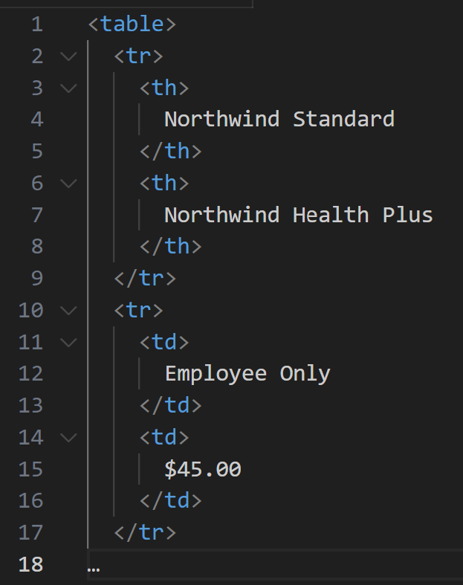
Document Chunking
Including Table Content
Forms Recognizer Output
"tables": [
{
"rowCount": 4,
"columnCount": 3,
"cells": [
{
"rowIndex": 0,
"columnIndex": 1,
"kind": "columnHeader",
"content": "Northwind Standard"
},
Notes:
Structured table content from Forms Recognizer is converted to HTML, and HTML tags are treated like words for the purpose of forming sections. Azure OpenAI understands HTML well because it was trained on publicly available web pages. It understands the table structure using the tags. Care is taken to avoid having tables span multiple sections to preserve as much of the table structure as possible for Azure OpenAI.

Slide 21
了解检索
Azure Cognitive
Search
Search Index
Notes:
Retrieval is a crucial part of the AI Powered Question and Answering pattern. Let’s look more into how Azure Cognitive Search powers Retrieval Augmented Generation.

Slide 22
Azure Cognitive Search
Keyword Search
Semantic Search
Vector Search
Hybrid Search
基于精确关键词
通过布尔搜索确定相关性
BM25排名
相关性基于用户查询的语义并检测特定于领域的模式
（例如哪个城市是法国的首都？）
数据的向量表示
利用向量和语义的力量
向量搜索
第一关
前 50 名检索
语义搜索
L2 重新排名
Serverless – private preview

Slide 23
5 个结果中按搜索类型划分的效果排名
Notes:
https://techcommunity.microsoft.com/t5/azure-ai-services-blog/azure-cognitive-search-outperforming-vector-search-with-hybrid/ba-p/3929167

Slide 24
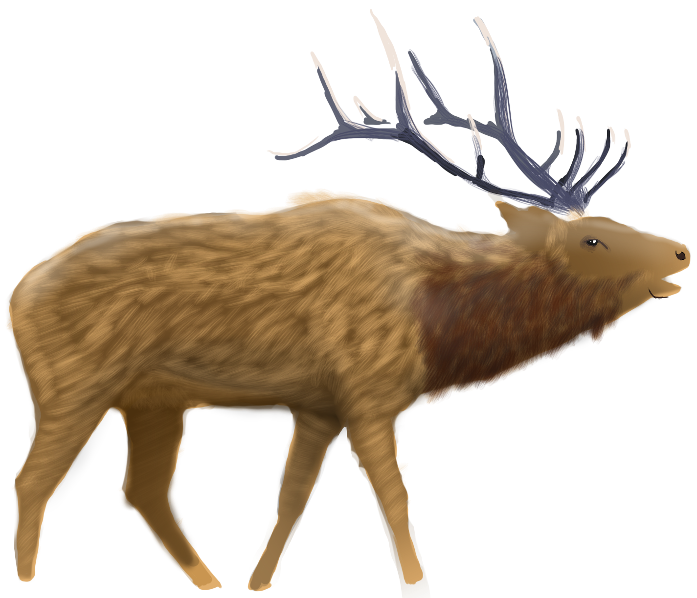
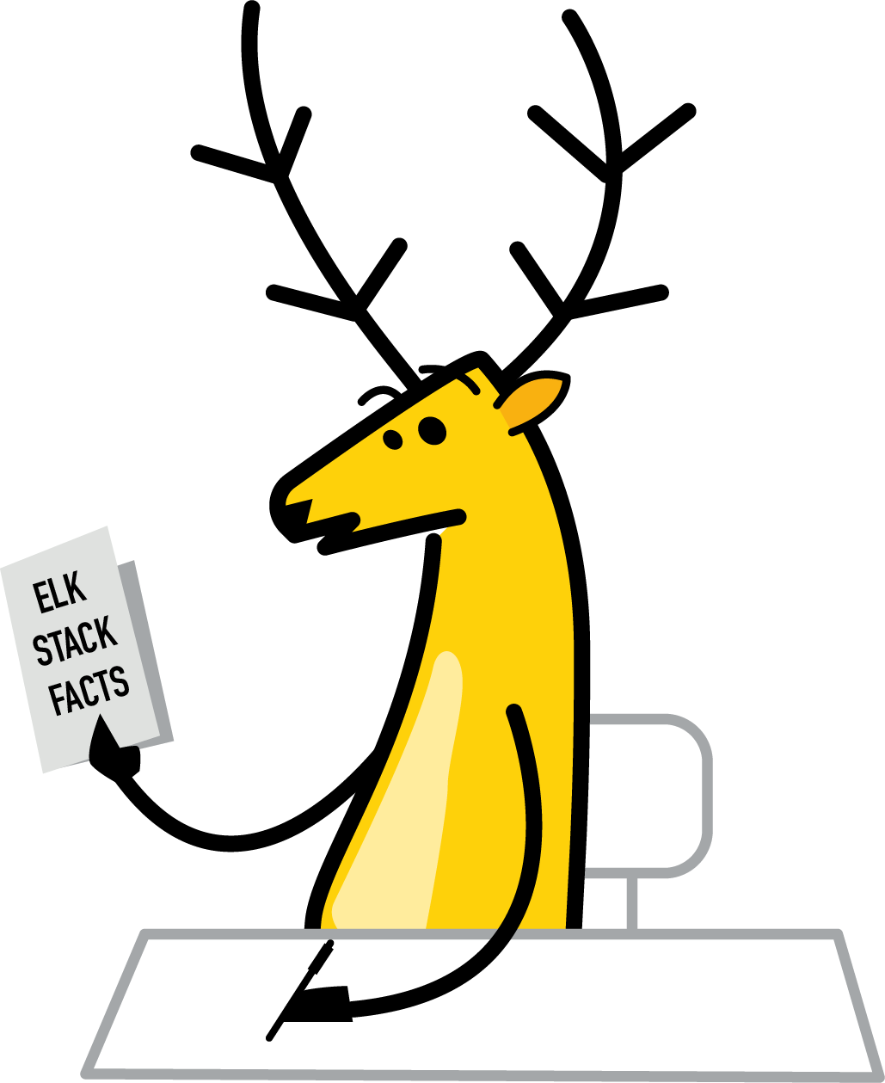

嵌入代表您的数据 Example: 一维向量
REALISTIC
CARTOON
Notes:
An embedding is a special format of data representation that can be easily utilized by machine learning models and algorithms.
The embedding is an information dense representation of the semantic meaning of a piece of text.
Each embedding is a vector of floating-point numbers, such that the distance between two embeddings in the vector space is correlated with semantic similarity between two inputs in the original format.
For example, if two texts are similar, then their vector representations should also be similar.

Slide 25
多个维度代表数据的不同方面
MAMMAL
REALISTIC
CARTOON
BIRD

Slide 26



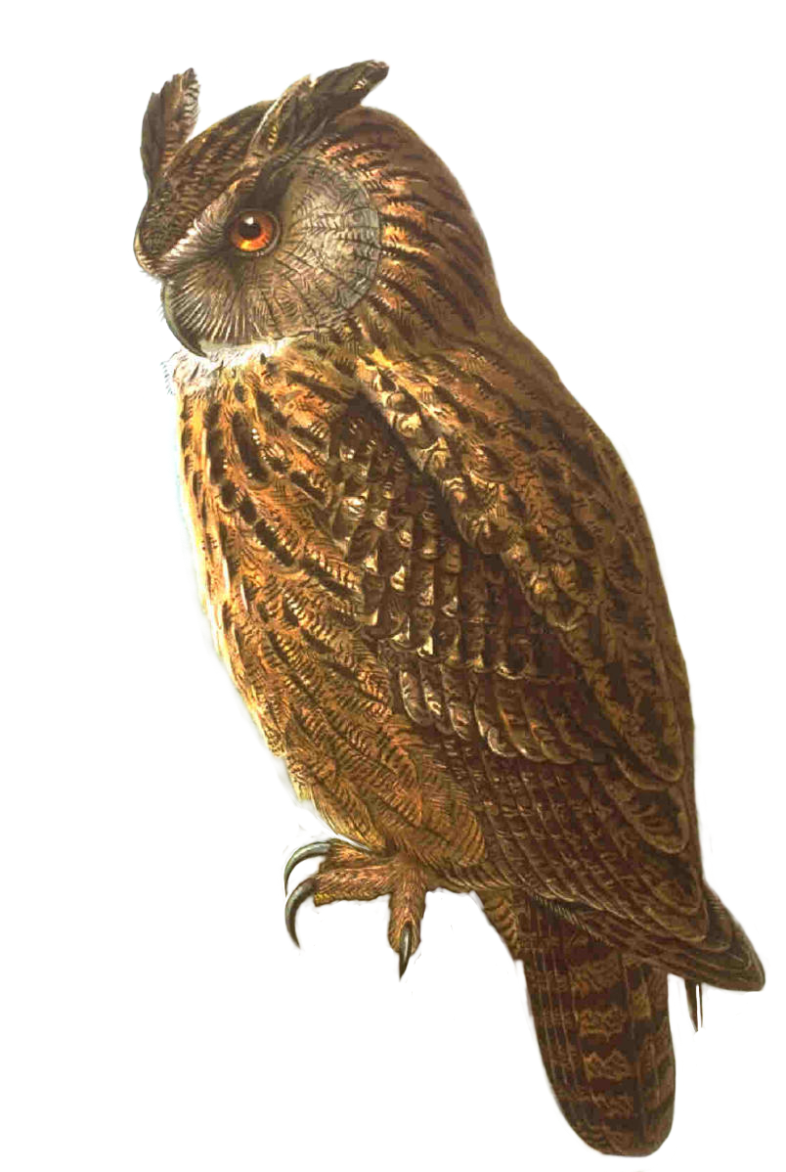


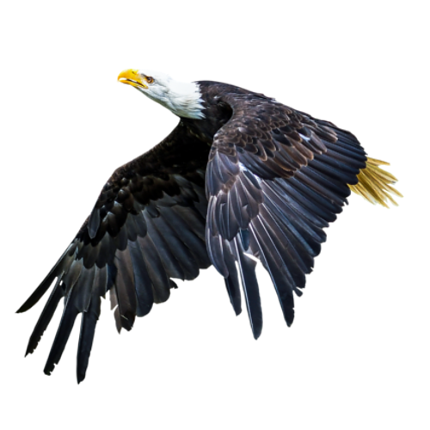

在“嵌入空间”中，相似的数据被分组在一起
MAMMAL
Where would I live in this embedding space?
REALISTIC
CARTOON
BIRD

Slide 27
嵌入使得将内容映射到“语义空间”成为可能
A neutron star is the collapsed core of a massive supergiant star
A star shines for most of its active life due to thermonuclear fusion
The presence of a black hole can be inferred through its interaction with other matter
[ 15 34 24 13 …]
[16 22 89 26 …]
[ 20 13 31 89 …]

Slide 28
使用嵌入进行相似性搜索 将内容编码为嵌入后，您可以从用户输入中获取嵌入，并使用它来查找语义上最相似的内容
user input
embedding
result set
“What is neutron star?” a
[ 13 33 34 13 … ]
Azure OpenAI embeddings tutorial—Azure OpenAI | Microsoft Learn

Slide 29
了解提示方法
Search query / questions (incl. filters, facets, scoring profiles, etc.)
?
User
Application
Search Index
Response:
Summarization,
Q&A, references, etc.
Azure OpenAI
Service
N-Relevant Sections
Prompt
Notes:
Using Azure OpenAI to answer questions requires a way of combining your data with your question, known as a prompting approach, We found several prompting approaches that are effective. Prompting approaches are being continually developed and change over time. Each one has different tradeoffs, and which approach to use depends on your scenario.

Slide 30

Model Catalog meets key enterprise requirements
Data privacy
Security and Compliance
Responsible AI and
Content Safety

Slide 31
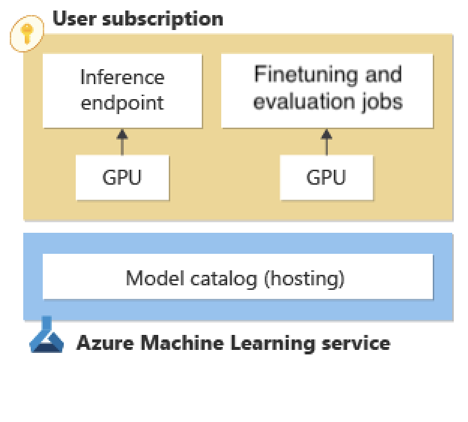
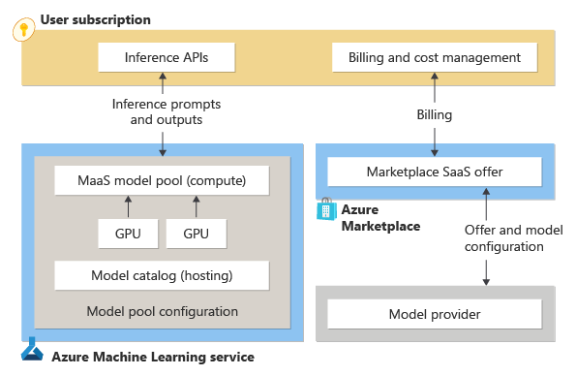
Data privacy
Managed compute
Serverless APIs
Your prompts and completions are not shared with model providers
Your prompts and completions not used for training models

Slide 32
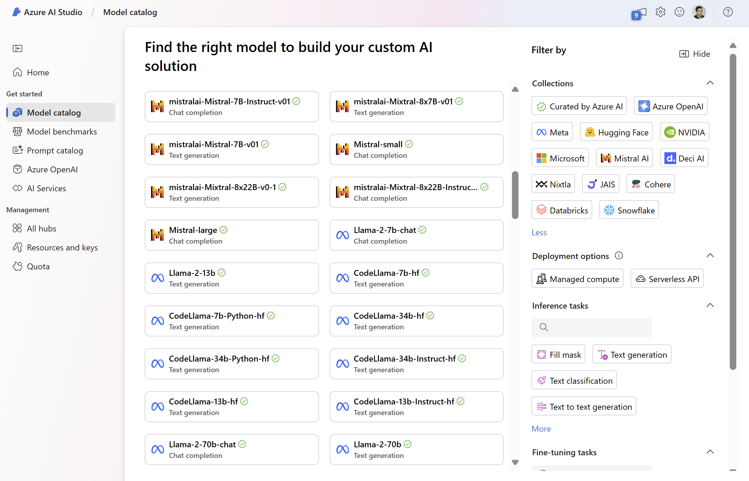
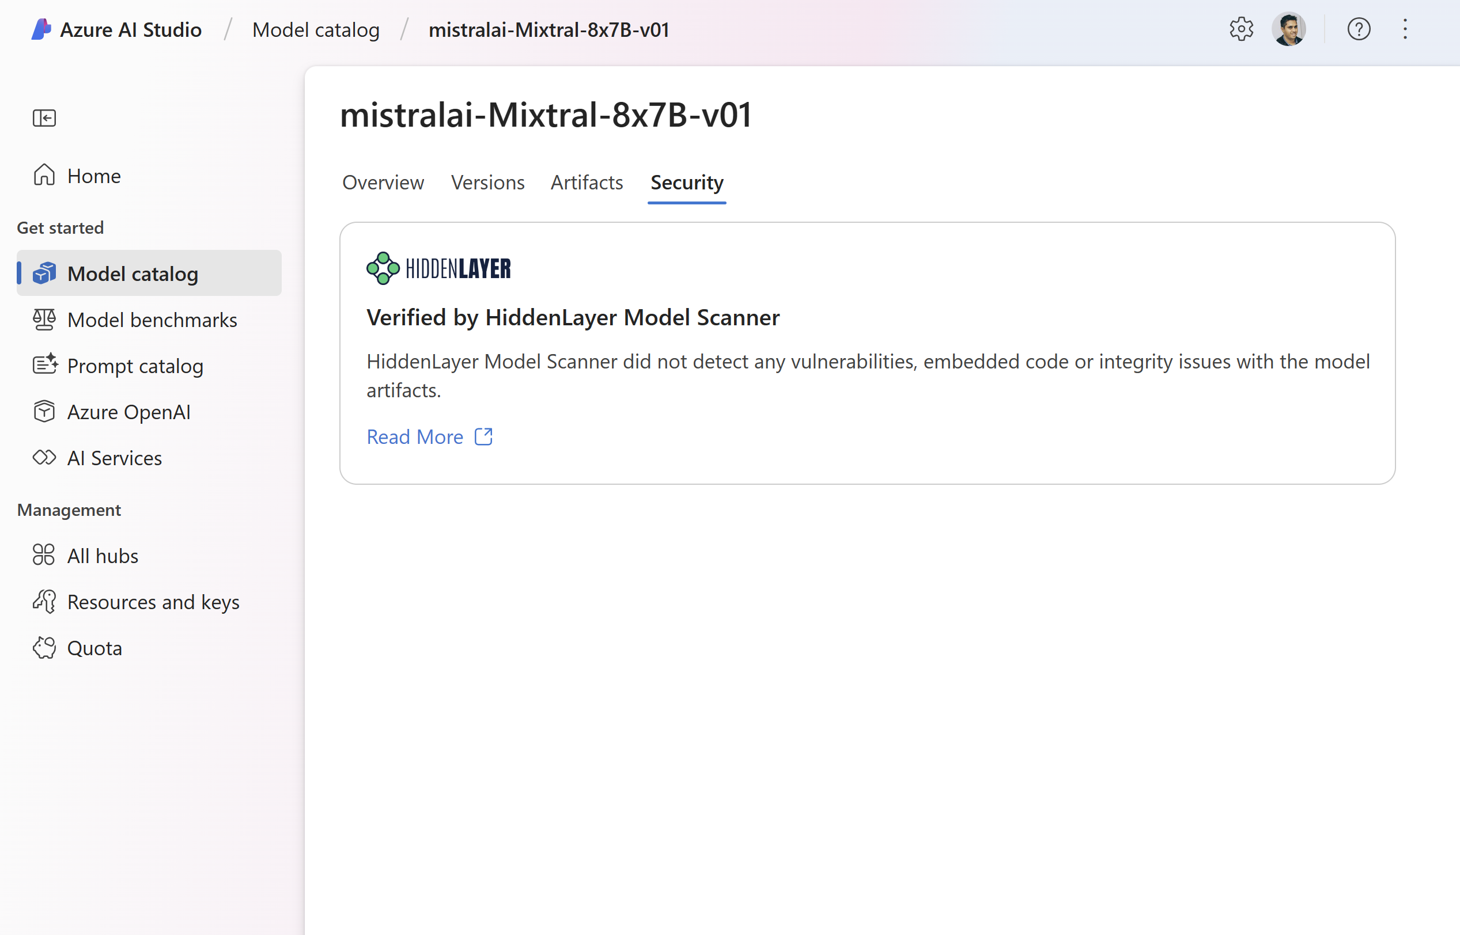
Vulnerability scanning with Hidden Layer model scanner
Finds embedded malware and backdoors
Scans for common vulnerabilities and exposures
Detects tampering and corruption across model layers

Slide 33
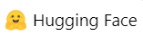
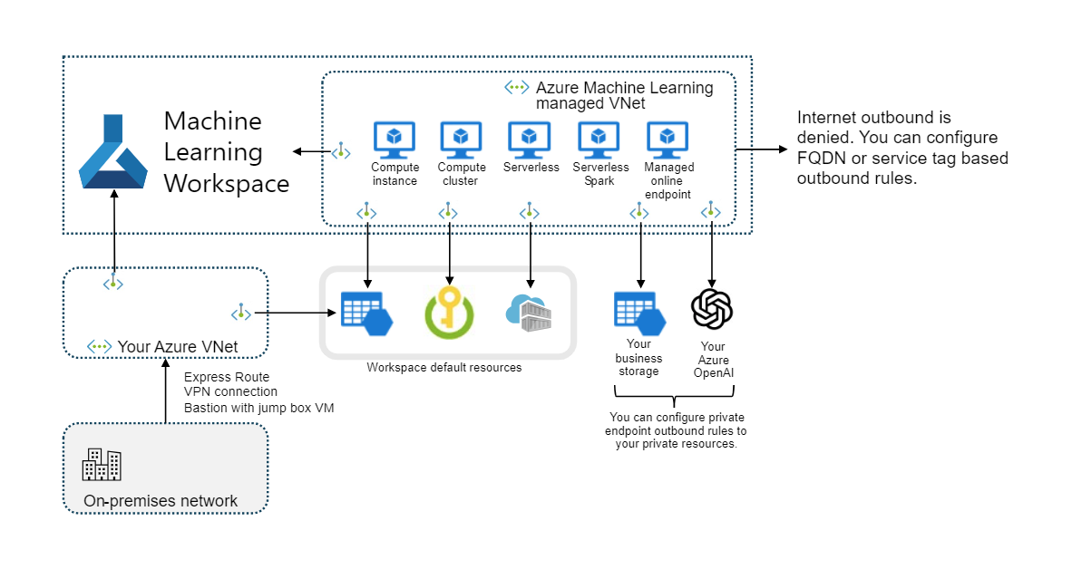
Security and Compliance
Model Catalog infrastructure
Built-in service endpoint policy to AzureML managed storage accounts and Microsoft Container Registry
Allow outbound FQDN rules for Hugging Face Hub and Docker Hub
Private networking – your data is not exposed to the internet
Route inbound and outbound traffic through Virtual Networks
FQDN rules to approve outbound to non-Azure resources

Slide 34
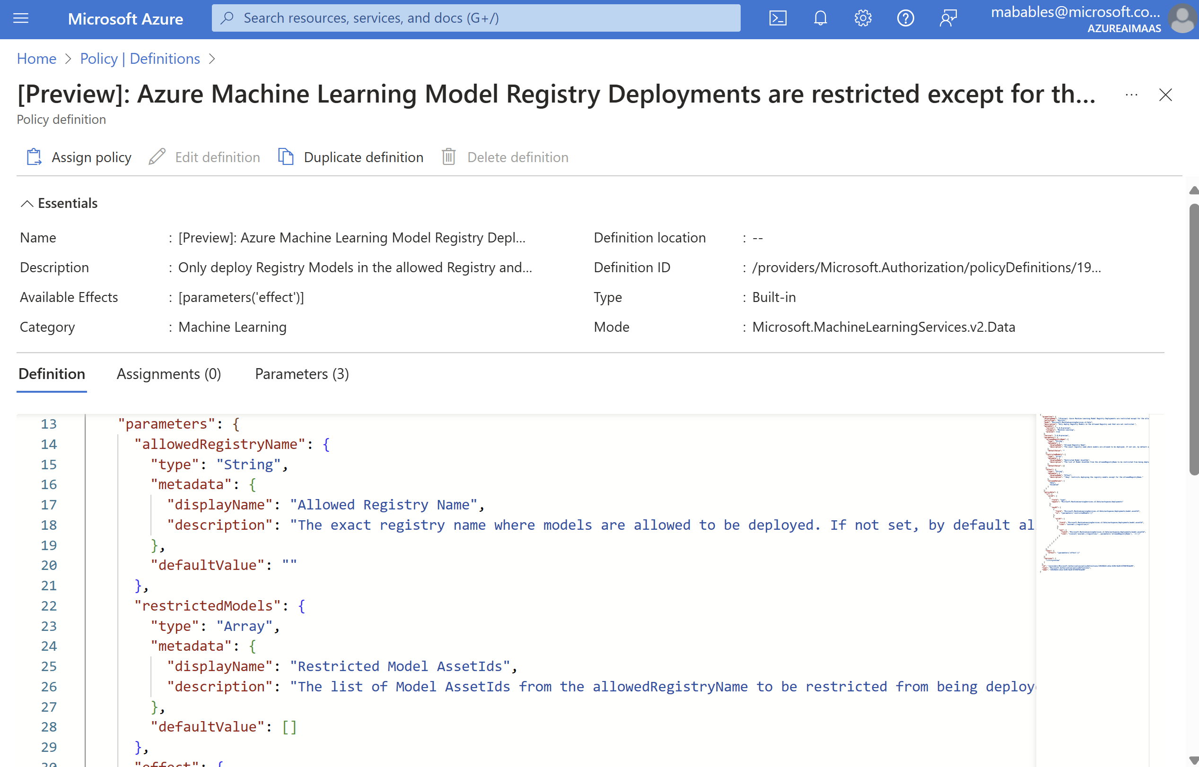

Security and Compliance
Regulate access to models with Azure policy integration
Allowlist or Denylist patterns
You can configure different policies for dev/test and production environments

Slide 35
Azure AI Inference SDK 从研发到部署的利器

Slide 36
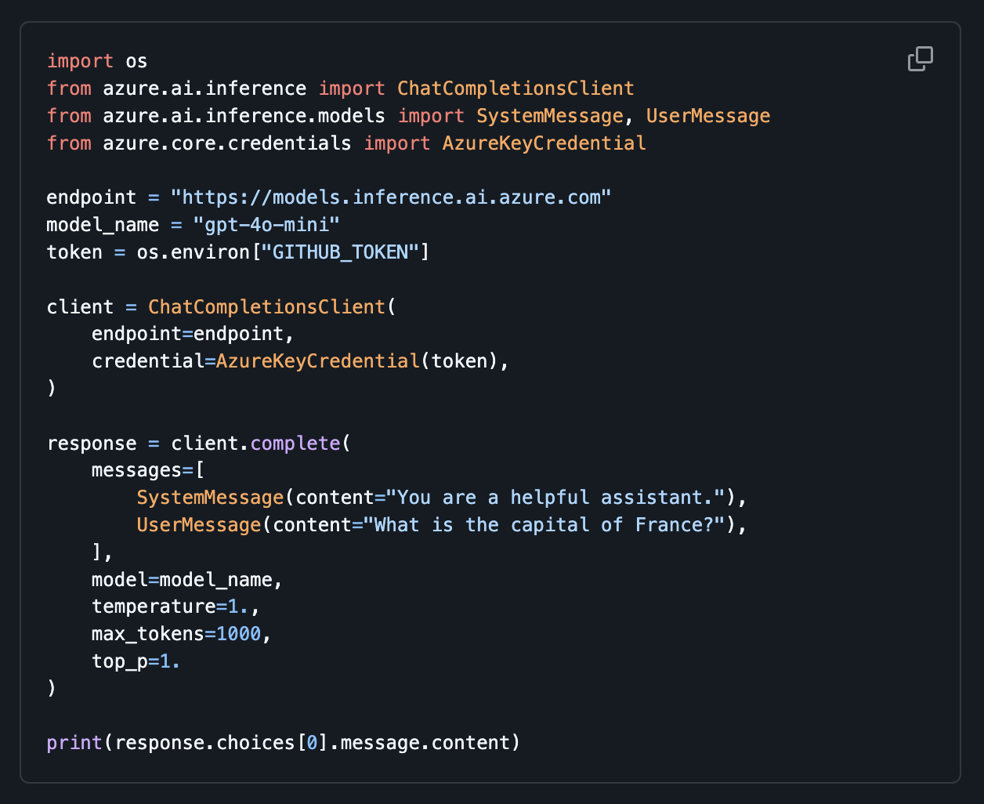
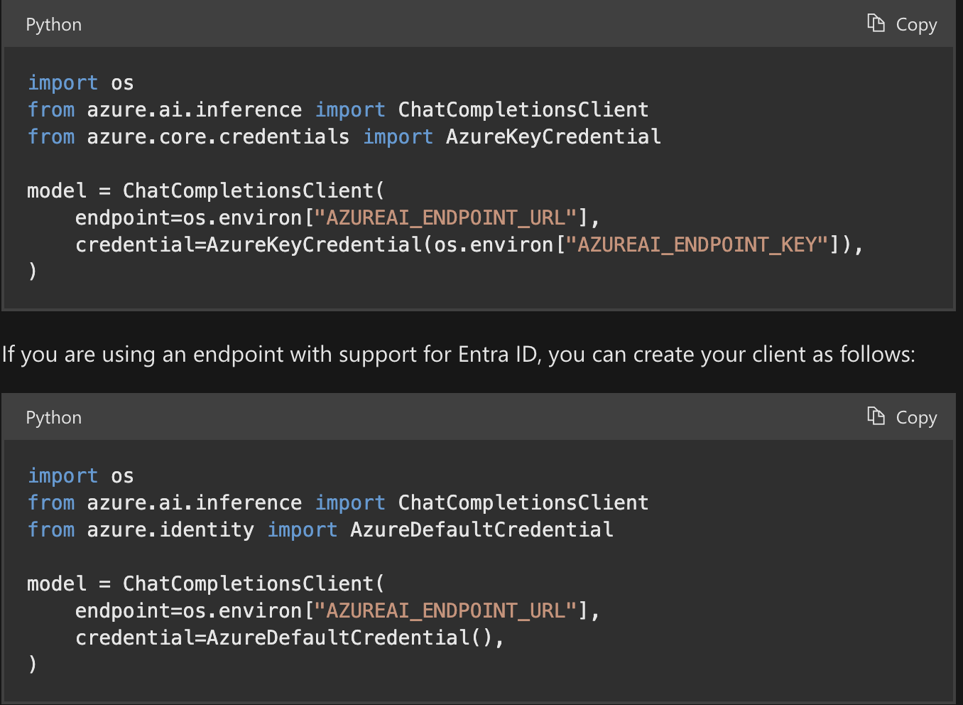
打通从研发到部署的 SDK
azure-sdk-for-python/sdk/ai/azure-ai-inference/samples at main · Azure/azure-sdk-for-python (github.com)

Slide 37


Slide 38
RAGHack: Next steps
aka.ms/raghack
Register for the hackathon @ aka.ms/raghack/register
Hack, hack, hack! Try our code samples or start from scratch!🧑🏿‍💻 👩🏻‍💻 👩🏼‍💻
For any questions, post in GitHub forum or attend Discord Office Hours. 🙋🏼 🙋🏾‍♀️
Join more live RAG sessions! aka.ms/raghack/streams
Submit your project before September 16th 11:59 PM PT to win prizes! 💵

Slide 39
Thanks

